Slide 1
User Requirement Analysis
on
Donors Choose

Slide 2
Group Members
180041208
Fida Kamal
180041214
Fariha Fairoz Nohan
180041229
Alvi Aveen Khan

Slide 3
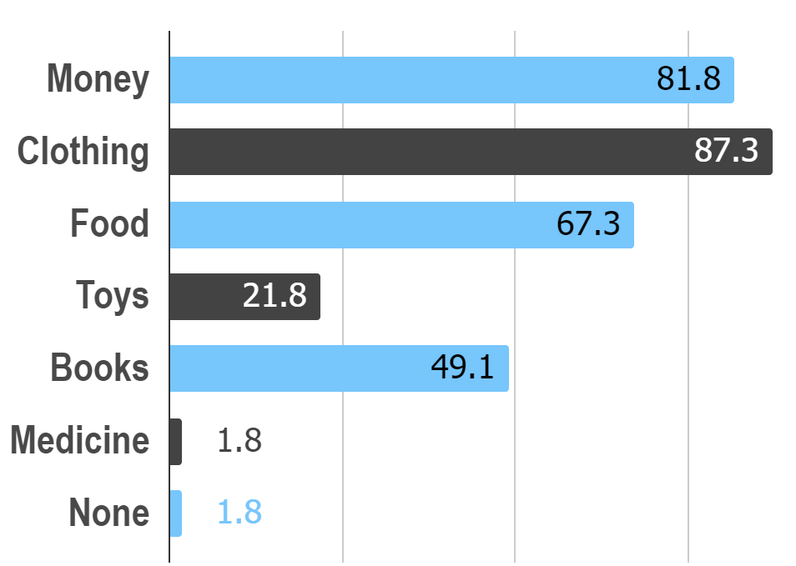
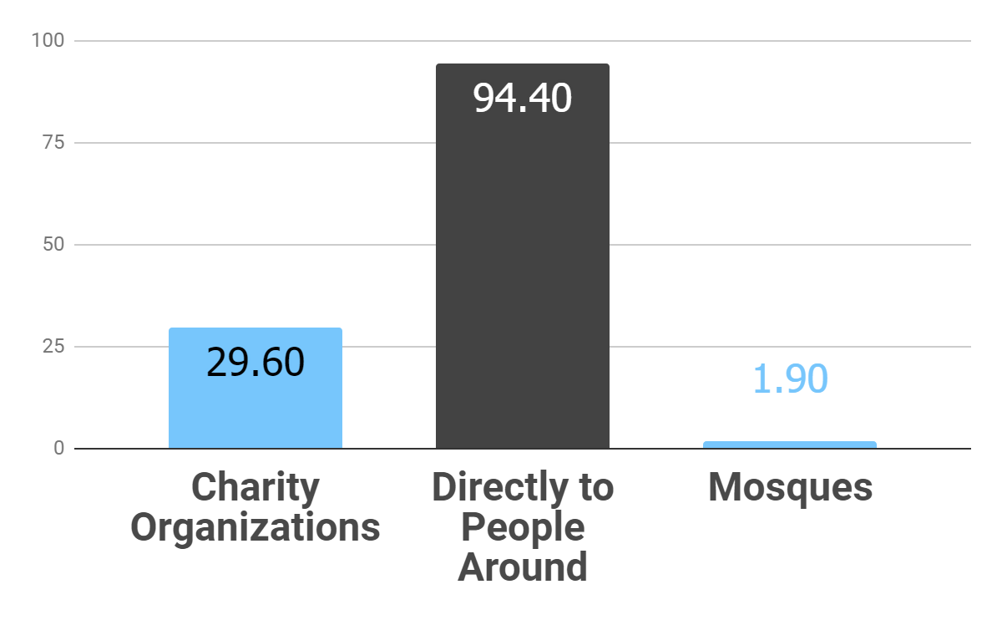
Current System
Forms of Donations
Methods of Donation
55
Responses

Slide 4
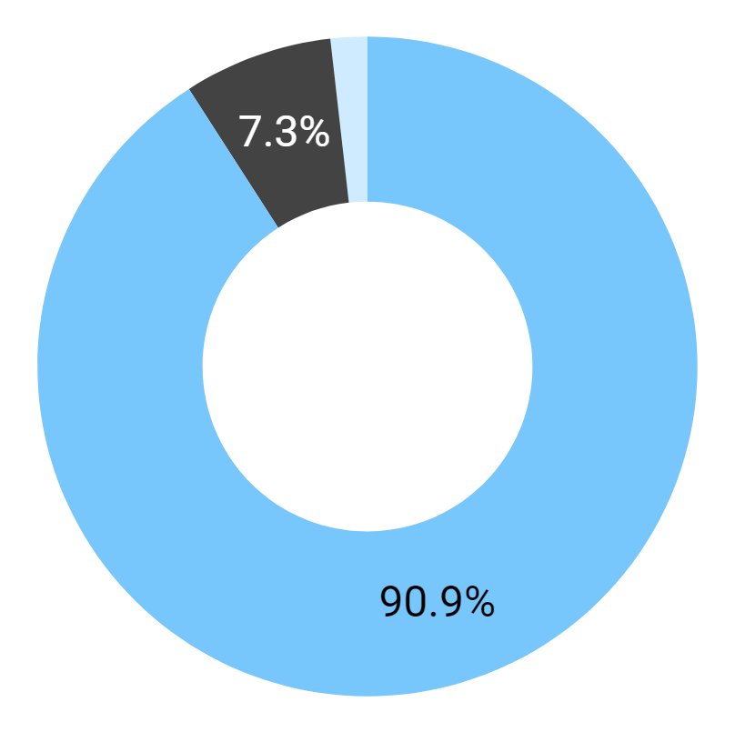
Problems
Gathering Information During Crises
Feel they cannot find a proper platform for donations
78.2%
Want to stay up to date about charities they like
Find it difficult and want to be informed about what specifically to do to help
Find it difficult but still want to do it themselves
Do not find it difficult
94.5%

Slide 5
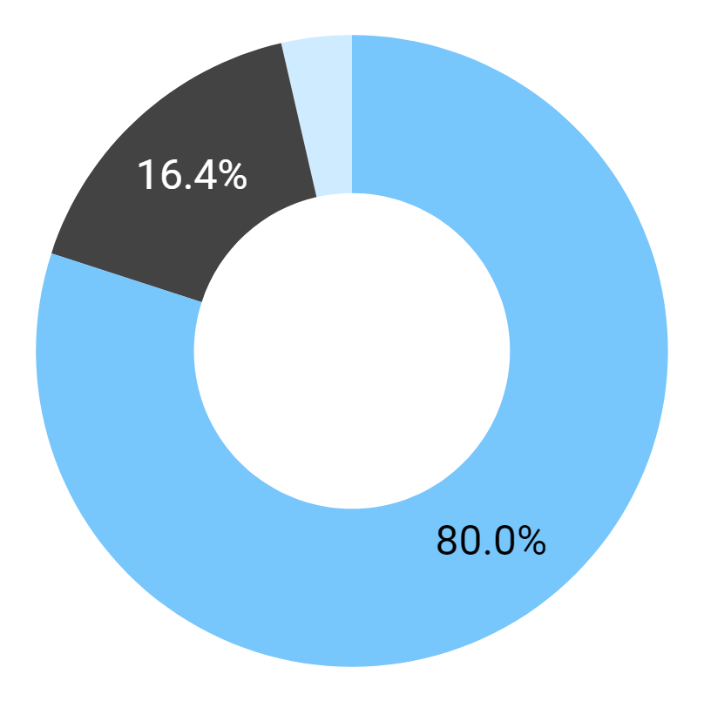
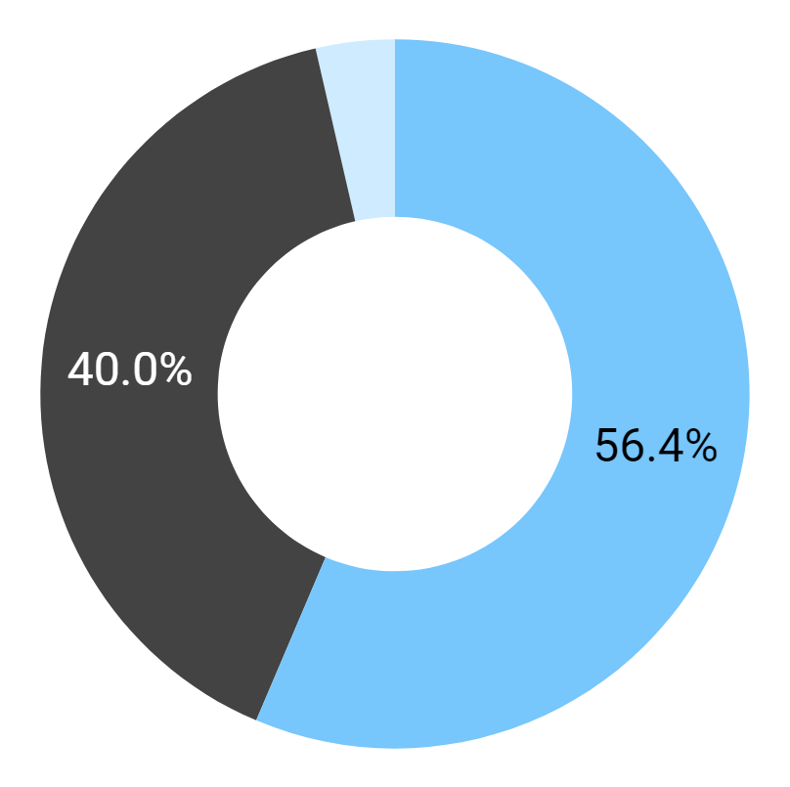
Problems
Verifying Reliability of Charities
Outcomes of Donations
Find it difficult and would prefer a platform that handles the task
Find it difficult but want to do it themselves
Do not find it difficult
Want to be notified
Are fine either way
Do not want to be notified

Slide 6
47.3%
52.7%
00.0%
of users think having an organized platform for all types of donations would make the process of donating easier, and also make them more likely to donate
think the same, but think they would probably not donate more frequently than they currently are
think it would not help

Slide 7
Personas
and
Scenarios

Slide 8
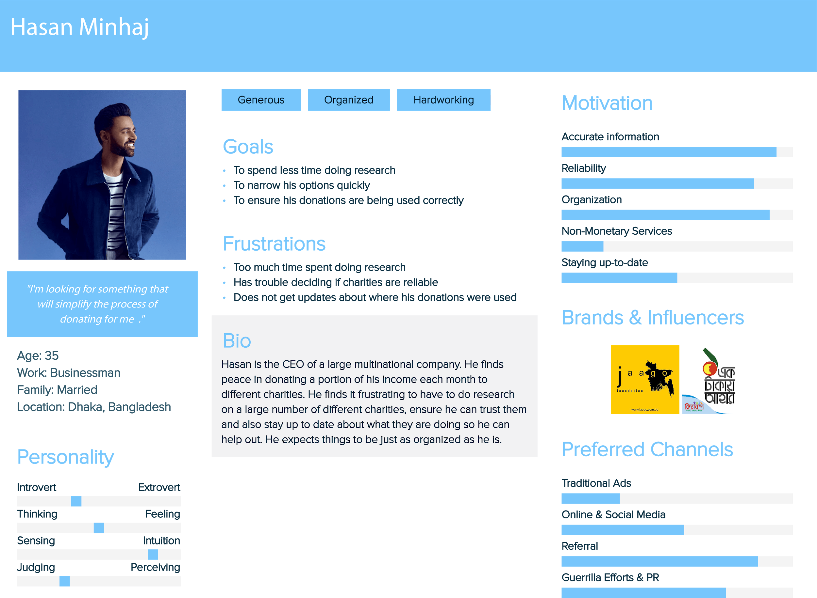

Slide 9
Scenario #1
Hasan is overwhelmed by all his commitments. He promised to donate a part of his income to different charities, but left the details to his secretary. Now he has to figure out what to do himself. As soon as he starts, he is irritated by the disorganization of most of the charity websites. He isn't technologically competent, and is finding it difficult to navigating the sites. He also needs to comb social media pages of every single one to make sure he isn't being duped.
After hours of work, he manages to make a few donations. He hopes these were the right ones, but has no way to make sure. None of them offered any updates. Sadly, this is the best he can do.

Slide 10
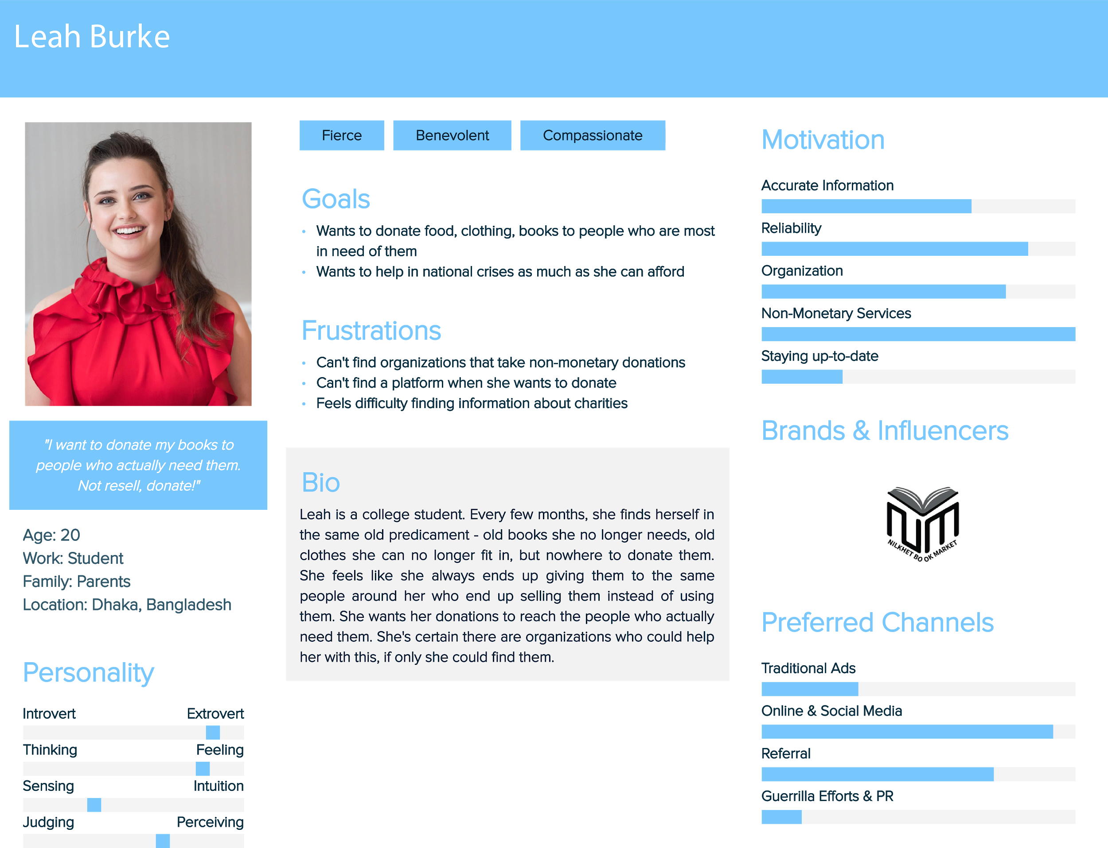

Slide 11
Scenario #2
Leah has finally gotten break after her HSC exams. She decides it's time to clean up the mess she's made of her room. Combing through mountains of clothes, books and dust, she create piles of all the books she no longer needs, and all the clothes she's outgrown. She asks her mother what she can do with this stuff, and is told to leave it by the door for the house help. Leah is certain giving them away to whoever is close by just means everything will be resold as second-hands. She wants her things to go to people who actually cannot afford to buy them.
Leah does some research, but it's not easy. Most charities highlight 52 different ways to donate money, but not much else. In the end, she gives up as she fails to find a proper platform.

Slide 12
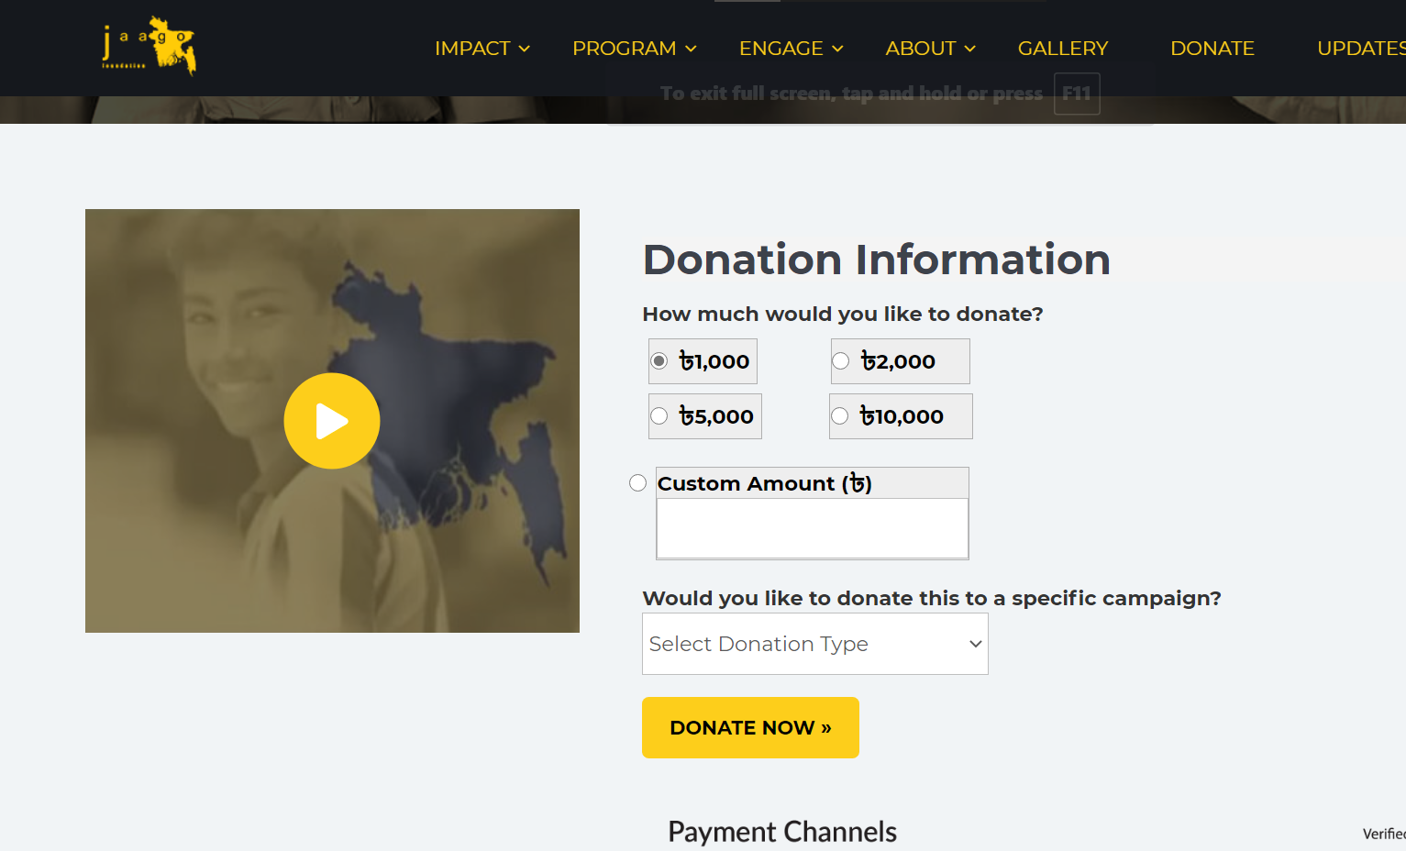
Current System
Search through websites manually to find charities
Mostly takes monetary donations through websites
Most organizations that accept non-monetary donations are not famous, and are thus difficult to find
Must check social media to see reviews and ensure reliability

Slide 13
Requirements
Must Have
Wish to Have
Profile page for charities
Category-wise division of donation types
Notifications about future events
Information during crises

Slide 14
Requirements
Must Have
Wish to Have
Verification via user reviews
Outcomes of donations
User profiles
Suggestions to include services like Kickstarter, or services to exchange products will not implemented, since they are not compatible with the motives of this project.

Slide 15
THANK YOU!

